Slide 1
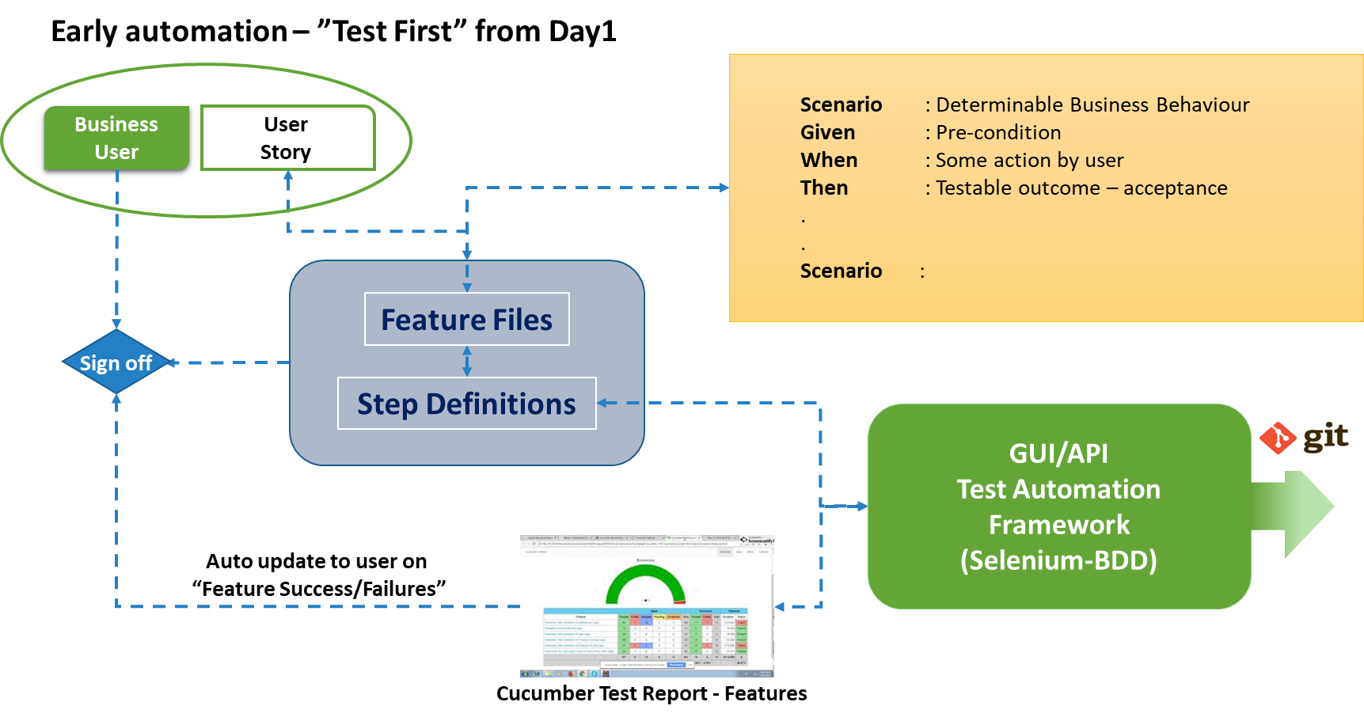
Behavior Driven Development
50%
30%
16%
Get a 50% reduction in test activities as a result of increased use of Automated Test
Get a 30% reduction in time spent on Definition of Requirements
Get a 16% savings from
the integration of CI/CD
In total get a
20-30% reduction in development costs
as well as a higher end-to-end quality

Slide 2
The Traditional Challenges
Customer
Long time from identification of the needs until actual implementation is completed
The quality team is normally involved late in the process leading to defect leakage
Traditional agile development requires many internal resources to do manual testing
Supplier
Frequent changes in requirements leads to
Uncertainty
Reduced quality in sprint planning
Reduced access to right resources
Interlock dependency problems
Consequences
Change requests
Contract discussions
Cost overrun
Time overrun
Quality reduction
Integration problems

Slide 3
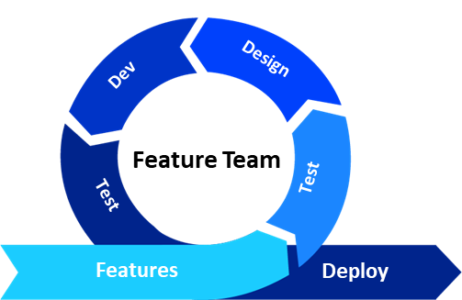
What is BDD?
Behavior Driven Development (BDD) and testing is a methodology to decrease the gap between the end user and the actual application built
BDD uses natural language in a structured way (Gherkin language) to describe the ’future actual behavior’ of an application in a common notation that can be understood by domain experts, developers, testers, and end users, leading to an increased stability of requirements
BDD helps to reduce the end-to-end costs, mainly in automation of testing, but also by reducing defect leakages, and prepare for reuse
Time to Market
Cost Transformation
Efficiency Gain
Benefits
Minimized Time–to-Market
High degree of test automation,
Early life cycle validation (re-confirmation of req’ts)
Easy to trace script failures and implement quick fixes
Minimized Cost
40-60% reduction in test efforts (automated vs. manual testing)
20-30% reduction in automated script development and maintenance efforts
Enhanced Quality
Increased user satisfaction due to enhanced business user participation and due to the live documentation of features and user stories available.
High test coverage will lead to high defect detection rates (>90%)

Slide 4
© Promantus Inc.
Raleigh, NC, USA
www.promantusinc.com
How to Transition to BDD
BDD is a methodology introduced only four years ago and it has been adapted mainly with customers in the financial industry and in only in few geographies
Since most companies are aware of BDD; and since they have not yet implemented BDD partially or entirely, companies both on the customer side and on the supplier side need to take a number of strategic decisions:
Is the customer able to and willing to invest the resources to present the requirements in a ”Feature File” format?
Is the supplier willing to replace the majority of manual testing with automated testing based on the Feature Files?
Are both parties willing to target the 25% potential savings by committing to a joint BDD process?
Implementing BDD with Promantus
Make a 5-day workshop arranged by Promantus
Get Promantus’ support to develop ”Feature Files” for the customer – either by working directly for the
customer or to work for the supplier to translate requirments
received from the cutomer into ”Feature Files”. Both partiess
shall subsequently approve the ”Feature Files” to be a full
replacement of the original requirement specifications
Promantus recommends to start with a medium sized project in order not to provide excess stress to any of the organizations
Promantus recommends that we subsequently participate in ”Lessons Learned Sessions” and also to build repositories for reuse of specifications

Slide 5
© Promantus Inc.
Raleigh, NC, USA
www.promantusinc.com
Promantus’ Value Propositions
Promantus Help Clients to Identify and Document Requirements
Bridge the gap between business and technology by defining acceptance criteria using shared business terminology. Help building the “Feature Files” (Requirements)
Development of Automation Testing Scripts
Participating in the process Promantus can help to eliminate manual tests in order to support multiple deployments build verification with test automation
Document Reusable Steps
As advisors Promantus can ensure that developers and testers are able to reuse step definitions with ‘action words’
Refactoring of Test
Promantus can help to establish and maintain business terminology scenarios
CI/CD Pipeline Integration
Promantus can do continuous integration (CI) support helping the client to use tools like Jenkins, Bamboo and more
Feature History Tracking
Promantus delivers project oversight in order to track the requirements life cycle of features, from creation to the latest release
Native BDD support
Promantus can help to align the client’s teams to streamline workflow with Behavior Driven Development

Slide 6
© Promantus Inc.
Raleigh, NC, USA
www.promantusinc.com
Workshops
Purpose
Promantus is offering workshops to companies both on the customer side and on the supplier side in order to prepare for a smooth transition to use BDD either as a supplement to or as a replacement to the traditional TDD methodologies
The workshop for suppliers also includes how to support a client in developing “Feature Files”
Max 10 participants per workshop to maintain efficiency
Workshop for Customers
A 5-day workshop
5-10 key people from customer
2 facilitators + one admin from Promantus
Based on Promantus real cases – ”Feature File” focus
Based on Feature File Scenarios – ”BDD Test Automation Script” focus , Workshop held on customer’s premises
Fixed price – USD 26,000
Workshop for Suppliers
A 5-day workshop
5-10 key people from customer
2 facilitators + one admin from Promantus
Based on Promantus real cases. ”Testing” focus
Based on Feature File Scenarios – ”BDD Test Automation Script” focus , Workshop held on customer’s premises
Fixed price – USD 26,000

